Slide 1
AC Motor

Slide 2
Course outcome
C403.4: Identify and select various electrical machines based on their characteristics and applications.

Slide 3
THREE PHASE INDUCTION MOTOR

Slide 4
Introduction
The induction motors are basically ac motors.
They can operate on either single phase or three phase ac supply, however the single phase induction motors are suitable only for few applications.
In almost 85% applications the three phase induction motors are preferred.
Depending on the type of rotor, the induction motor are classified into two types, slip ring induction motors and squirrel cage induction motors.

Slide 5
Advantages of induction motors over DC motors:
Low maintenance requirement.
Ruggedness, smaller size and weight.
Low cost.
They can operate in dusty and explosive environment.
They can operate at much higher speed.
It can produce sufficient torque.
Speed control by using thyristors can give a wide range of speeds.

Slide 6
Disadvantages of induction motors:
The efficiency of induction motors varies with speed.
They have low starting torque.
They have a lagging and low power factor.
Speed control by electrical methods is not easy.

Slide 7
Applications of induction motors:
Fans
Pumps
Extruders
Conveyors
In food and chemical industries
Paper and sugar industries etc.
Chemical, textile, mines and traction etc.

Slide 8
Rotating Magnetic Field (RMF)
The induction motor operates on the principle of rotating magnetic field(RMF) which is produced by the stator winding of the induction motor in the air gap between the stator and the rotor.
The stator is a three phase stationary winding which can be either star connected or delta connected.
Whenever the ac supply is connected to stator winding, line current I_{R}, I_{Y} and I_{B} start flowing and these line currents are 120⁰ phase shifted with respect to each other.

Slide 9
Due to each line current a sinusoidal flux is produced in the air gap. These fluxes have the same frequency as that of line currents and they are also 120⁰ phase shifted with respect to each other.
Let the flux produced by line current I_{R} be ø_{R}, that produced by I_{Y} be ø_{Y} and that produced by I_{B} be ø_{B}.
Mathematically
ø_{R} = ø_{m} sin ωt
ø_{Y} = ø_{m} sin (ωt-120⁰)
ø_{B} = ø_{m} sin (ωt-240⁰)

Slide 10
Production of RMF:
The effective or total flux (ø_{T}) in the air gap between the stator and rotor is equal to the phasor sum of the three component fluxes ø_{R,} ø_{Y} and ø_{B} .
∴ ø_{T} = ø_{R} + ø_{Y} + ø_{B}
The magnitude of ø_{T} at any value of θ from 00 to 3600 is constant.
ø_{T} rotates in the clockwise direction in space. One rotation of ø_{T} corresponding to one cycle.

Slide 11
2. Speed of RMF:
The RMF rotates at a speed called synchronous speed N_{s} which is given by,
N_{s} = 120 f₁ / P RPM
where f₁ = frequency of stator supply
P = Number of poles of the motor.

Slide 12
3. Direction of RMF :
The direction of RMF depends on the sequence of the ac supply being connected to the stator winding.
RMF rotates in the clockwise direction if the phase sequence is R, Y, B.
But if the sequence is changed, the direction of RMF will reverse.

Slide 13
Construction of Induction Motor
An induction motor consists of two main parts:
Stator 2. Rotor
The stationary frame called stator and the rotating armature called rotor.
Fig.(1) shows the construction of a three phase induction motor.
The function of various parts is as follows:
Frame: It provides the mechanical support to entire construction. It contains the stator winding.
2. Air gap: Air gap provides the space for the rotating magnetic field between stator and rotor.

Slide 14
3. Fan: The fan rotates with the rotor. Its function is to cool down the motor.
4. Slip rings: The rotor winding terminals are permanently connected to the slip rings. The slip rings are continuously in contact with three brushes which are pressed against slip rings. External connections from brushes are brought out.
Similar to stator, the rotor drum is provided with slots.
The stator can be a star connected or delta connected and connected to the 3 phase ac supply.
The current flows through the rotor due to the principle of induction. Hence the name induction motor.

Slide 15
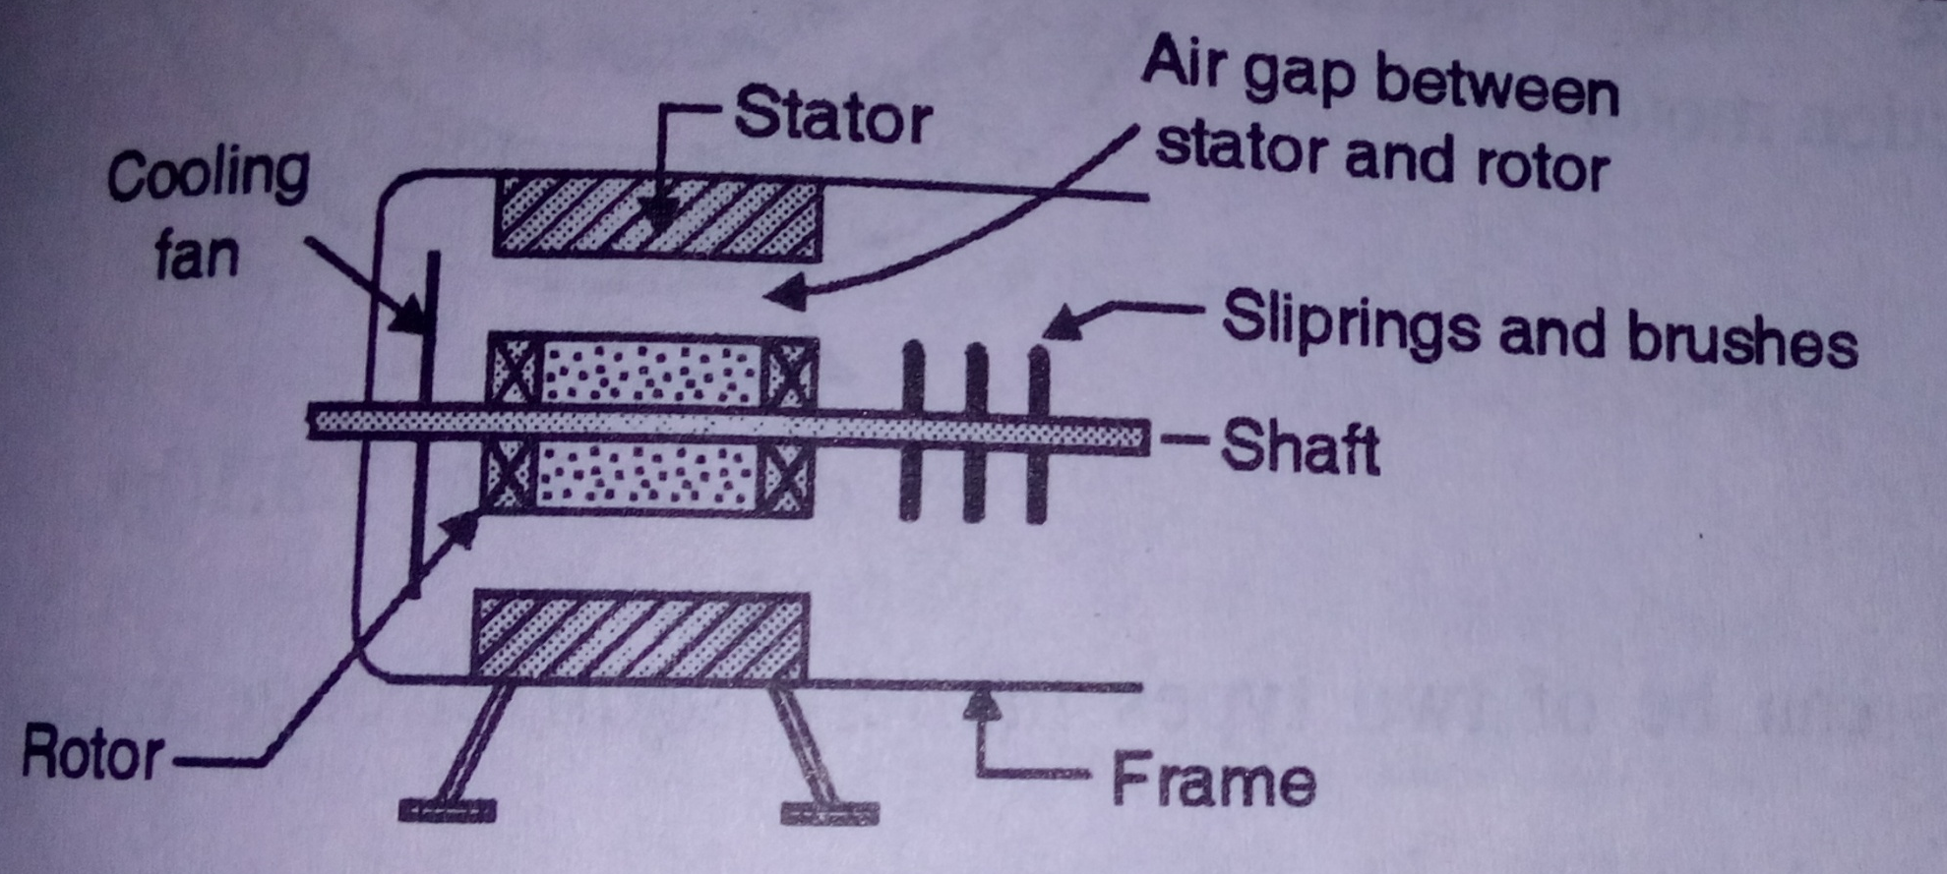
Fig.(1): construction of three phase induction motor

Slide 16
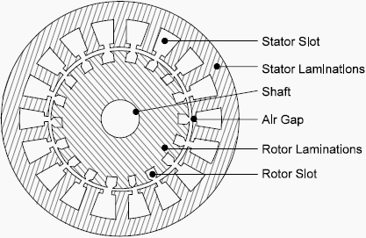
Fig.(2): three phase induction motor

Slide 17
Principle of Operation
The three phase stator winding of induction motor is connected to the three ac supply.
Due to ac voltage applied, current starts flowing in the stator conductors.
Due to three phase stator current, a rotating magnetic field (RMF) of constant amplitude and rotating at a constant speed is set up in the air gap between stator and rotor.
The rotor winding is not rotating. So rotating magnetic field cuts the stationary rotor conductors and induced emf in the rotor winding.
The rotor induced voltage gives rise to currents.
So rotor current will flow in such a direction that the rotor will experienced a force that accelerates it in same direction as that of RMF.

Slide 18
Synchronous Speed (N_{s})
The synchronous speed is the speed at which the rotating magnetic field rotates.
N_{s} is dependent only on the stator frequency f₁ and number of poles P.
N_{s} = 120 f₁ /P

Slide 19
Slip (s)
The difference between the synchronous speed (Ns) and the actual motor speed (N) is indicated by the slip “s”.
% slip = (N_{s} – N)/N_{s} x 100 %
The actual speed N can be expressed in terms of s as,
N = N_{s} (1-s)
The value of slip will vary between 0 and 1 for motoring operation.

Slide 20
Torque-speed characteristics
The torque speed characteristics of induction motor can be divided into three sections:
Forward motoring
Plugging
Regeneration
Forward motoring:
The forward motoring region corresponds to the values of slip between 0 and 1.
In this region, the motor rotates in the same direction as that of rotating magnetic field.
The torque increases as the slip increases while air gap flux remains constant.
Once the torque reaches its maximum value at critical slip s_{m}., the torque decreases with increase in slip due to reduction in air gap flux.

Slide 21
The region of (0 < s < s_{m}) is known as the stable region of operation and the operating point of the motor should be in this region of the characteristics.
This is stable region because in this region with increase in the torque demand, the motor speed decreases.
The region of (s_{m} < s < 1) is unstable region because in this region with increase in torque the speed of the motor increases.
Generating region:
For the generating region, the slip needs to be negative and in between 0 and -1.
The torque produced is in opposite direction to that of the motoring mode so it is shown to be negative.

Slide 22
Plugging or counter current braking:
The motor operates in the plugging or counter current braking mode for values s > 1.
To get values of s > 1, N must be negative i.e. Ns and N must have opposite directions i.e. the RMF and rotor should rotate in opposite directions.
This is achieved by interchanging any two phases of the stator .

Slide 23
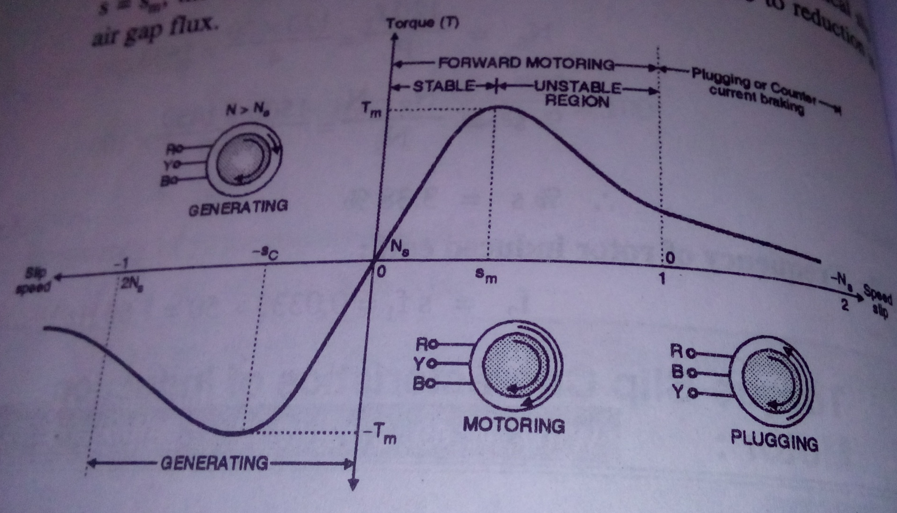
Fig.(1): Speed-Torque characteristics of induction motor

Slide 24
Speed control of Induction motor
Speed control of induction motor by using variable frequency drive (VFD):
We know that the actual speed N is given by,
N = N_{s} (1 – s)
and N_{s} = 120 f₁ / P
So we can change the actual speed by changing the synchronous speed. But synchronous speed is changed by changing the stator supply frequency f₁.
So theoretically we can control the speed by changing only f₁.
But only change in f₁, keeping V₁ constant has an adverse effect on the air gap flux because air gap flux is given by,
ø_{ag} ∝ (V₁ / f₁)
If f₁ is reduced by keeping V₁ constant then there is a possibility of core saturation.

Slide 25
Hence the ratio (V₁/f₁) is kept constant by changing both the stator voltage V₁ and frequency f₁ simultaneously. This is necessary to keep the air gap flux constant.
Hence this method is called as constant (v/f) control. It is also known as variable frequency drive (VFD).
The block diagram of constant (V/f) control is as shown in fig.(1).

Slide 26
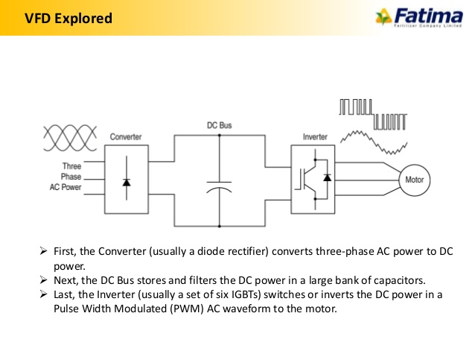
Fig.(1): constant (V/f) control for induction motor

Slide 27
Operation:
The ac input of constant voltage and constant frequency is applied to an AC to DC converter which is a rectifier.
At the output of AC to DC converter we get a DC voltage. A capacitor bank is used to reduced the ripple content in the DC voltage.
This DC voltage is applied at the input of an inverter. This inverter converts the DC voltage into a 3 phase variable voltage variable frequency AC voltage.
This voltage is applied to the stator winding of the motor. Thus we get the constant V/f control.

Slide 28
Starter
The rotor current under running condition is given by,
|I_{2r}| = s E₂ / (R₂² + s² X₂²)^{1/2} …..(1)
where E₂ = rotor induced emf at stand still. At starting when the motor is at stand still s = 1.
∴ |I_{2r}| = E₂ / (R₂² + X₂²)^{1/2} …..(2)
but E₂ = (N₂/N₁) V₁, at stand still
∴ E₂ = KV₁
∴ |I_{2r}| = KV₁ / (R₂² + X₂²)^{1/2} ……(3)
From eq.(3), it is clear that rotor current at starting depends on:
1. stator voltage V₁ and
2. leakage reactance of rotor (X₂).
If the rated stator voltage is applied to the motor at the time of starting, the motor will draw heavy starting current.

Slide 29
This will lead to excess I2R losses in the winding which will overheat the motor.
Secondly due to a heavy current drawn from the ac supply, at the time of starting its supply voltage will reduced.
The heavy starting current may damaged the motor winding as well.
In order to avoid these problems, we can use some kind of a starter to limit the starting current of the induction motor.

Slide 30
Star-delta starter:
Here the stator winding of the motor is connected in star configuration at the time of starting. This reduces the voltage across each winding to 1/√3 of the rated voltage.
When the motor accelerates, the stator is connected in delta configuration, to apply the rated voltage to the winding.
The starting torque reduced as the torque is proportional to square of voltage and there is jerk while switching from star to delta.
Fig.(1), shows the arrangement for star delta starter.

Slide 31
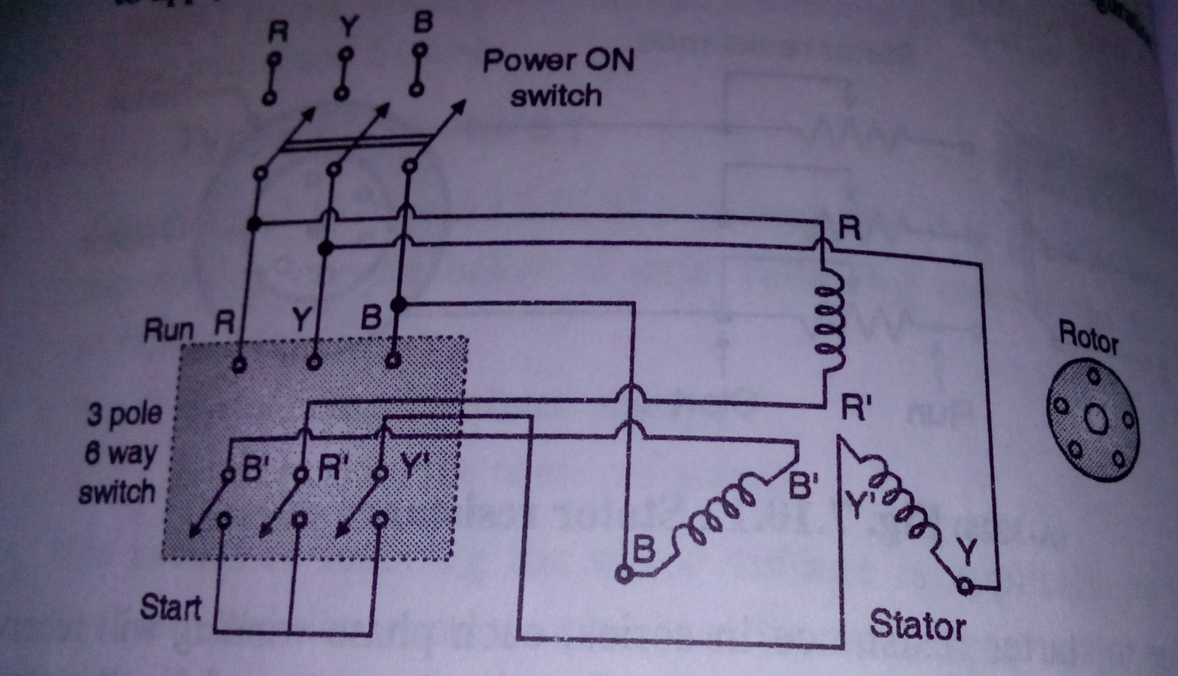
Fig.(1): star delta starter

Slide 32
Start mode:
The 3 pole 6 way switch is kept in the start mode first. This will connect the R’, B’ and Y’ terminals of the stator windings to each other. This acts as the star point.
This supply is connected to R, Y and B terminals of the stator winding. Thus in the “start” mode the stator windings are connected to form a star.
Equivalent circuit for the “start” mode is as shown in fig.(2a).

Slide 33
Run mode:
The 3 pole 6 way switch is thrown into the “Run” position once the motor accelerates.
This will connect the stator winding in the following manner,
R B’ , Y R’ and B Y’
This is shown in fig.(2) which illustrates how the stator winding is connected to form a delta.

Slide 34
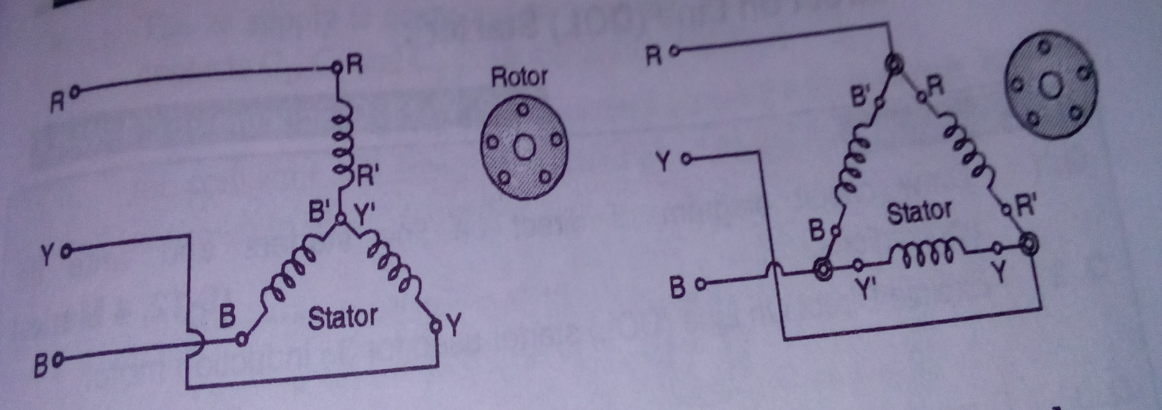
In the start mode (b)In the run mode
Fig.(2): equivalent circuits for star delta starter

Slide 35
2. Direct on Line (DOL) starter:
The DOL starter is as shown in fig.(3).
It consists of fuse links connected in each line, thermal overload relay contacts, contactor contacts and start stop logic in series with each line.
Operation:
To start the motor, press the start switch. The stop switch in series with it is a press to off switch.
As the start switch is pressed, the contactor coil get connected across the lines Y and B.
The armature rod shown by dotted lines is pulled towards the contactor coil and normally open contacts C₁, C₂, C₃ and C₄ will be closed

Slide 36
The ac supply is connected to stator winding through contacts C₁, C₂ and C₃ as shown in fig.(3).
The additional contact C₄ is connected across the start switch. It keeps the contactor coil energized even after releasing the start switch.
If we want to stop the motor, then press stop switch.
This will disconnect the contactor coil from ac supply, all contacts are open circuited and the stator disconnected from the ac supply.
Same thing will happen if the ac supply fails. Afterwards when the ac supply is restored, we have to press the start switch again to start the motor.

Slide 37
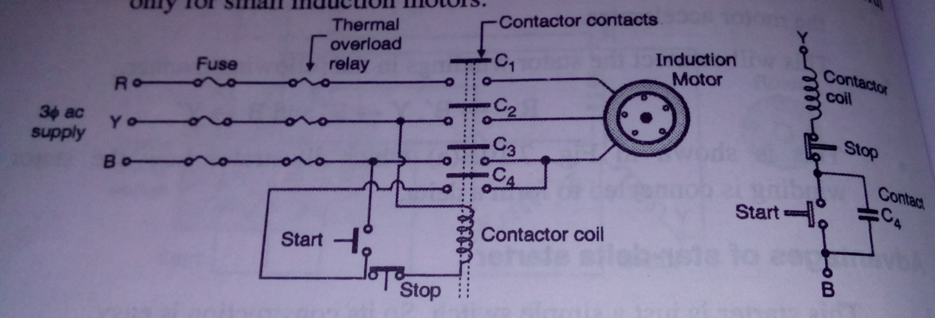
Fig.(3): DOL starter

Slide 38
Specifications of induction motor
Important specifications of a 3 phase induction motor are as follows:
Number of phases
Stator connection
Rotor type
frequency
Rated stator voltage
Base speed RPM
Power output kW/HP
Insulation
Power factor
duty

Slide 39
SPECIAL MOTORS

Slide 40
Single Phase Induction Motor
It is more convenient to use single phase ac motors instead of d.c. motors. Practically single phase a.c. motors are used in most of the applications.
Construction:
A single phase induction motor has two main parts namely stator (the one which is stationary) and rotor (the one which is rotating).
The stator winding is connected across a single phase a.c. supply. The ac supply produces a rotating magnetic field in the airgap between the stator and rotor.

Slide 41
The field rotates at a speed called synchronous speed and it is denoted by Ns.
The induction motor actually rotates at a speed which is slightly less than the synchronous speed.
As shown in fig.(1), the rotor consists of copper or aluminium bars which are permanently short circuited at both the ends using the conducting rings called end rings.

Slide 42
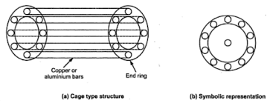
Fig.(1): construction of a squirrel cage rotor

Slide 43
Principle of operation:
A single phase ac supply is connected to the stator winding. This forces an alternating current through the stator winding. This current produces an alternating flux in the air gap between stator and rotor.
The alternating flux passes over the rotor conductors and induces an emf into it due to transformer action.
Due to this induced voltage, a current starts flowing through the rotor conductors. This current will then produces its own flux called as rotor flux
The main flux produced by the stator winding interacts with the rotor flux to produce the torque.

Slide 44
The rotor flux gets produced due to the principle of induction hence it is called as induction motor.
But single phase induction motor are not self starting, like DC motors.
Types of single phase induction motor:
Some of the methods used to make an induction motor self starting. Based on these techniques, the single phase induction motor are classified as follows:
Split phase induction motor
Capacitor start induction motor
Capacitor start, capacitor run induction motor
Shaded pole induction motor.

Slide 45
Resistive Split Phase Induction Motor
The construction of split phase induction motor is as shown in fig.(1).
This motor consists of two winding namely the main winding and the auxillary (starting) winding.
The main winding is highly inductive while starting winding is resistive.

Slide 46
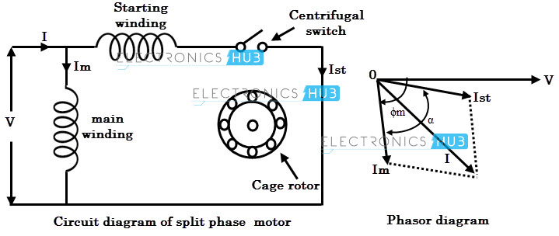
Fig.(1): Split Phase Type Induction Motor

Slide 47
Principle of operation:
The current flowing through the main winding (I_{m}) lags behind the V by 90⁰ since the main winding is highly inductive.
The current flowing through the starting winding (I_{st}) is almost in phase with the supply voltage V as this winding is resistive.
The fluxes produced due to these currents will be placed 90⁰ with respect each other. And the resultant of these fluxes will be a rotating magnetic field. Due to the RMF a non-zero starting torque acting in one direction will be produced.
The centrifugal switch connected in series with the starting winding gets automatically open circuited when the motor speed reaches about 70% to 80% of the synchronous speed.
After that the motor rotate only on the main winding. Thus under the running condition the auxillary winding remains out of the circuit.

Slide 48
The direction of rotation of split phase motor can be reversed by reversing the terminals of either main winding or starting winding. The direction of rotation changes due to the reversal in direction of rotating magnetic field.
Applications:
The starting torque of this motor is poor. So it is used in following applications:
Fans and blowers
Washing machines
Centrifugal pumps

Slide 49
Capacitor Start Induction Motor
The construction of this motor is as shown in fig.(1a).
As shown in fig, the starting winding connected in series with the capacitor draws a leading current while the main winding continues to draw the lagging current.
Due to this the fluxes produce a rotating magnetic field which result in the rotation of the motor.
The current (I_{m}) through the main winding will lag behi9nd the source voltage as the main winding is inductive. But the angle (I_{st}) through the starting winding leads the supply voltage by some angle due to the presence of capacitor. Hence the angle between the fluxes produced by I_{m} and I_{st} will be large as shown in fig.(1b).

Slide 50
Due to this large angle, the starting torque produced by the capacitor start motor produces a larger starting torque as compared to that produced by the split phase induction motor.
As soon as the speed reaches 75% to 80% of the maximum speed, the centrifugal switch is automatically open circuited and the starting winding alongwith the capacitor goes out of the circuit.
The induction motor will then be running only on the flux produced by the main winding.

Slide 51
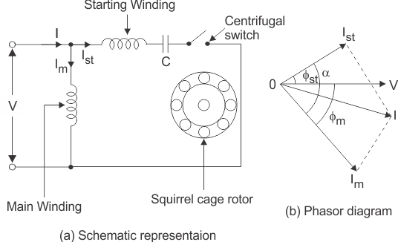
Fig.(1): Capacitor Start Motor

Slide 52
Capacitor Start Capacitor Run Motor:
Fig.(2) shows the construction of capacitor start capacitor run motor. It shows that there is no centrifugal switch, hence the capacitor will not go out of the circuit at all.
The direction reversal for capacitor type motors can be achieved by interchanging the connection of main and auxiliary windings.
This will interchange the fields produced by the two winding. The interchanged phase shifted fields will reverse the direction of the motor.
The main advantage of these motors is the high starting torque that they can produce. The starting torque can be as high as 300 to 400% of the full load torque.

Slide 53
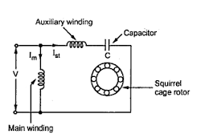
Fig.(2): Capacitor Start Capacitor Run Motor

Slide 54
Applications:
Due to high starting torque, the capacitor start or capacitor start capacitor run motors are used in the following applications:
Grinders
Compressors
Conveyers
Fans and air conditioners
Refrigerators

Slide 55
Shaded Pole Induction Motor
Fig.(1), shows the construction of a shaded pole induction motor.
Every stator pole is divided into two parts by keeping a small slit in the pole face and the smaller portion is covered with a thick short circuited copper wire called shading band.
When stator winding carries current, the main pole produces a flux ø_{m}.
This flux links with the shading band and this band cats as a shorted secondary winding, stator winding being its primary. Circulating currents induced tn the band produced nother flux ø_{s}.

Slide 56
At instant t₁ current is increasing. The induced emf tries to oppose it. Thus flux ø_{s} opposes it and resultant flux is in unshaded part.
At instant t₂ current is almost constant. Induced emf and flux ø_{s} are negligible. Resultant flux is almost at the center of the pole. Thus it has shifted its position.
At instant t₃ current is decreasing. The induced current and flux ø_{s} try to oppose this decrease. Resultant flux lies in shaded part.
This action continues and the resultant field rotates from unshaded part to shaded part. Hence rotor also rotates in the same direction.
The direction of rotation cannot be reversed unless position of shaded ring is changed from one part of pole to another part.

Slide 57
Such motor develops low starting torque and it has a low power factor..
Applications:
Table fans
Blowers
Washing machines
refrigerators

Slide 58
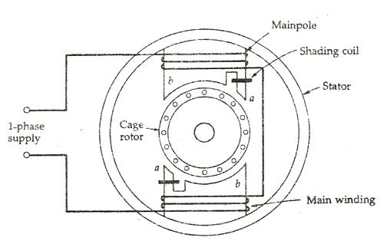
Fig.(1): shaded pole induction motor

Slide 59
Universal Motor
The motors which can be operated satisfactorily on ac as well dc supply is universal motor.
Types of universal motors:
Uncompensated type universal motor
Compensated universal motor
Windings:
There are three windings used namely armature, main field and compensating winding.
Out of which compensating winding is used only for the compensated universal motor.
All the windings are connected in series with each other since this is basically a series motor.

Slide 60
1. Uncompensated universal motor:
The operating principle is same as that of dc series motor.
Field winding produces flux. It is stationary winding. Armature is a rotary winding.
These motors produces high starting torque but their speed decreases with increase in load. Their speed regulation is not very good.
These motors having low capacity. Normally it is designed for two pole structure.

Slide 61
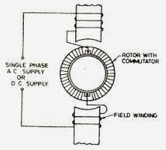
Fig.(1): Uncompensated Universal Motor

Slide 62
2. Compensated universal motor:
In this motor, main winding and compensating winding are distributed over entire stator.
Fig.(2) shows the schematic diagram of compensated universal motor.
This type of motor is better for higher speeds.
These motors are more expensive due to complicated construction. Hence they are preferred for higher capacity loads.

Slide 63
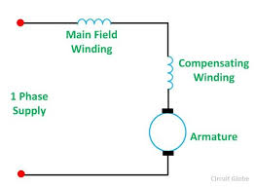
Fig.(2):compensated Universal Motor

Slide 64
Applications:
Washing machine
Mixers and grinders
Food processors
Small drilling machines
Vaccum cleaners
Sewing machine
Hair driers
Electric shavers

Slide 65
Specifications and ratings of a universal motor:
Sr. No. | Specifications/rating | Value
1. | Type | Compensated
2. | Rated voltage | 230 V
3. | Number of phases | 1
4. | Power | 0.5kW
5. | Speed | 5000 RPM

Slide 66
Stepper Motor
Converts series of electrical pulses (input) into discrete angular movements (definite angular steps) i.e one step for each pulse input.
Stator is constructed of laminated silicon steel.
As shown the stator has six salient poles or teeth on which coils are placed with opposite poles having series connected coils to which voltage pulses are given through the switching circuit as shown.
Rotor is also of laminated silicon steel with the no. of poles/teeth being four but has no coils.
The switching is done sequentially to obtain rotation.
When poles A & A’ are excited by closing Switch Sw1 the rotor teeth nearest to these align to have minimum reluctance between the A-A’ stator poles. (poles A and A’ are opposite in nature).

Slide 67
Next if poles B & B’ are excited by opening Sw1 and closing Switch Sw2 then the rotor moves anticlockwise angularly by 30º to align with these poles.
Thus if we provide 12 such voltage pulses sequentially by proper opening and closing of switches we get one full rotation in 12 equal steps.
If the sequence of application of these pulses is A/A’ – C/C’ – B/B’ then we obtain clockwise rotation.
By changing the no of rotor teeth proportionally we can have smaller angular steps.

Slide 68
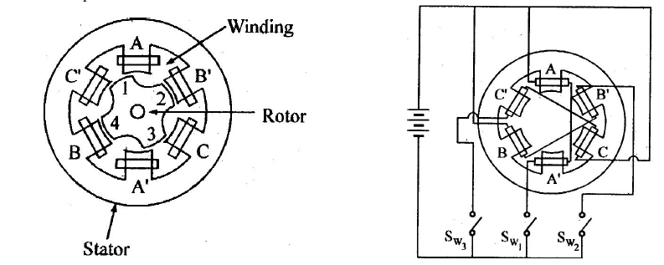
Fig.(1): Construction Of Stepper Motor

Slide 69
Applications:
In robotics and CNC machines
In computers, printers, tape readers etc.
In the applications like radars, satellite communication systems.
In position control applications.
In the biomedical applications.
NC control of machine tools.
Process control systems
XY recorders and plotters
watches

Slide 70
Specifications/ratings of a stepper motor:
Type
Number of phases
Number of poles
Maximum stepping rate
Maximum speed
6. Step angle
7. Slewing rate
8. Voltage
9. Torque

Slide 71
Servomotors
In automatic control system it becomes necessary to compare system parameters with some reference.
Whatever is the error it is amplified and used to drive motors known as servomotors.
Depending upon type od supply used, servomotors are classified into:
A.C. servomotor and
D.C. servomotor

Slide 72
A.C. servomotors:
Construction of ac servomotor is as shown in fig.(1).
Basically it is an induction motor with two windings provided on the stator.
One of the winding is called reference or main winding which is connected to constant magnitude ac voltage.
The other winding is called control winding which is connected to voltage obtained form servo amplifier.
For maximum flux linking air gap kept is minimum.
The ac servomotors are used in the frequency range of 50 Hz to 400 Hz and from milliwatts power consumption to few hundred watts.

Slide 73
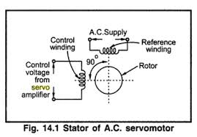
Fif.(1): A.C. servomotor

Slide 74
Applications:
Process control equipments
Machine tools
Instruments servos
Sewing machine
Robotics
Process controllers
AC position control applications
Portable drilling machines

Slide 75
2. D.C. Servomotors:
DC servomotor is an ordinary dc motor. But it is a separately excited dc motor. The dc servomotors are further classified into two types:
Armature controlled type and
Field controlled type.
In field controlled dc servomotors, the signal from the servo amplifier is applied to the field winding. The armature is connected to constant current source.
In armature controlled dc servomotor, the constant current source is applied to the field winding whereas the servo amplifier output is connected to the armature.

Slide 76
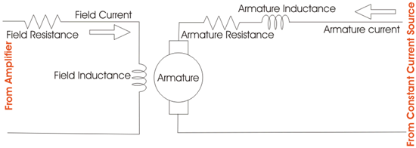
Fig.(2): D.C. servomotor

Slide 77
Applications:
Position control system
Process controller
Machine tools
Robotics
Aircraft control system
Servo stabilizers

Slide 78
ALTERNATOR

Slide 79
Introduction
The machines that generate a.c. emf are called synchronous generators or A. C. generators. It is also called as an alternator.
An alternator can be run as a motor called synchronous motors. Both these machines i.e. the alternator and synchronous motor work at a specific constant speed.
Hence, they are called synchronous machine.

Slide 80
Construction of an alternator
In alternator, field windings are placed on the rotor and the armature winding is placed in suitable shaped slots in the stator.
The field winding is connected to an external dc source called exciter, through a pair of sliprings as shown in fig.(1).
The armature winding is 3 phase winding and the induced voltage in this winding is supplied to the load. This is a 3 phase ac voltage.
When the excited rotor rotates, its magnetic field cuts the stationary stator conductor as a result of which a 3 phase ac voltage gets induced into the armature winding.

Slide 81
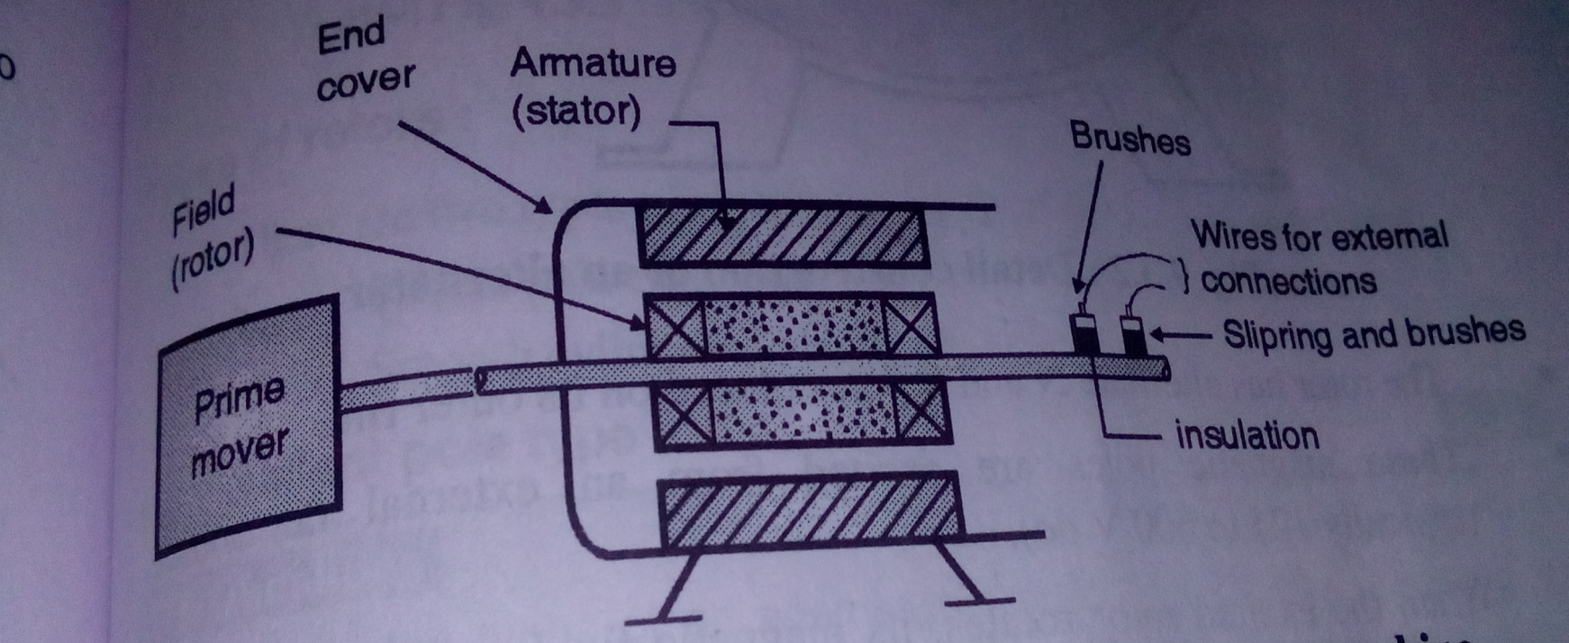
Fig.(1): Construction Of An Alternator

Slide 82
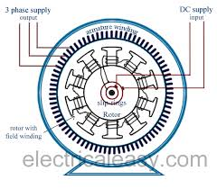
Fig.(2): Detail Construction Of An Alternator

Slide 83
Principle Of Operation
The fig.(1) shows the construction of single turn alternator to generate sinewave.
This alternator consists of a permanent magnet with two poles N and S and a single turn rectangular coil which is made up of two conductors p and Q.
These conductors are connected to each other on one end whereas there other ends are connected to the slip rings mounted on shaft.
The single turn coil can rotate around its own axis in clockwise or anticlockwise direction in the flux produced by the permanent magnet.
Due to rotation, the conductors P and Q cut the magnetic lines of flux produced by permanent magnet.

Slide 84
According to faraday’s law of electromagnetic induction, an emf is induced into the rotating conductors.
Due to this induced emf, current flows through the external resistance R.
The induced emf in the single turn coil is given by,
e = Blv sinθ
Thus the single turn alternator produces a sinusoidal voltage.

Slide 85
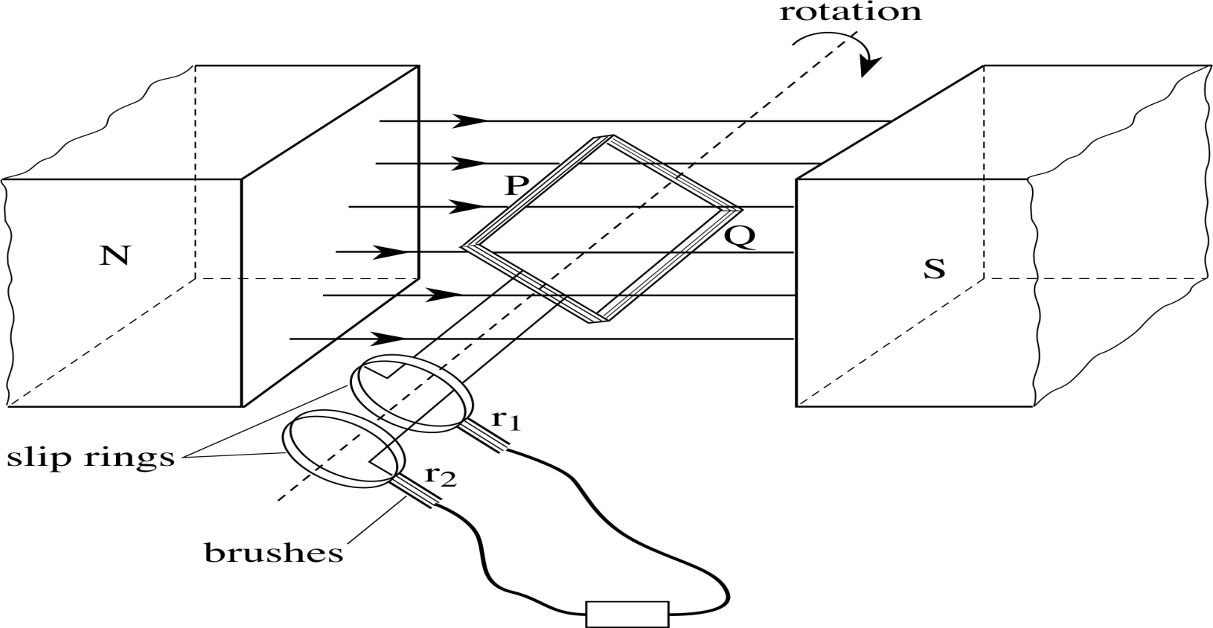

Slide 86
Applications
Hydroelectric power generation plant
Steam power stations
Wind mills
All the automobiles (two wheelers, cars, trucks, buses etc.)
Nuclear power stations

